Slide 1

BASIC PRINCIPLE OF
AUDIO
STEGANOGRAPHY
“TRY HARD”

Slide 2

OUR MEMBERS

Slide 3
NAME | ROLE | CONTRIBUTION PERCENTAGE
LE VIET ANH | CODING
VU TUAN PHUONG NAM | CODING
TRAN BAO HUY | REPORT MAKING
NGUYEN TU TUNG
DO THANH DAT | SLIDE MAKING + PRESENTING

Slide 4

PROBLEM STATEMENTS

Slide 5



Study Case:
“Lạy chúa trên cao lmao bủh bủh”
“!@#$#$%#$%#$%#$%#$#”
“Tối nay 9h chỗ cũ em nhé”

Slide 6

Stegano -graphy
Steganography is the practice of hiding a secret message inside of (or even on top of) something that is not secret. That something can be just about anything you want.

Slide 7

Continue
Technique: Conceal & Deception
Convert communication and involve the use of any medium to hide a message
NOT CRYPTOGRAPHY!

Slide 8
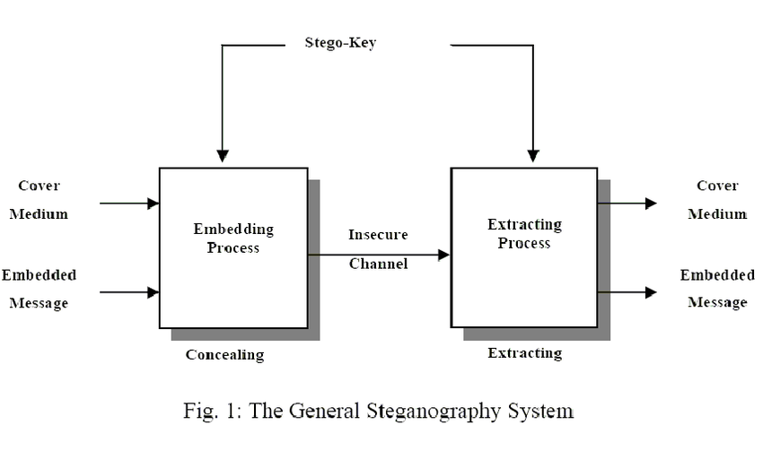
Continue
The term Steganography comes from Greek, which means covered or secret writing.
The following diagram simplify how it works:

Slide 9

Audio Steganography
Audio Steganography is the form in which we use digital sound in order to hide messages from people you don’t want them to see

Slide 10

Continue
It can embed messages in several sound files , like WAV, AU, or even MP3 sound files.

Slide 11

Continue
Several Techniques required:
- LSB Coding
- Phase Coding
- Parity Coding
- Spread Spectrum

Slide 12

OUR Project

Slide 13

Pros
Potential capability to hide an existence of confidential data
No difficult to detect the hidden data
Strengthening of the secrecy of the hidden data.

Slide 14

Cons
The confidentiality of information is maintained by the algorithm. If the algorithms are known, then this technique is useless.
Password leakage may occur leading to unauthorized access of data.

Slide 15

THANK YOU!

